Slide 2
Review Tutorial 1
Session 10
MATRICES
SYSTEMS OF LINEAR EQUATIONS
Session 9
PROBABILITY
COUNTING

Slide 3
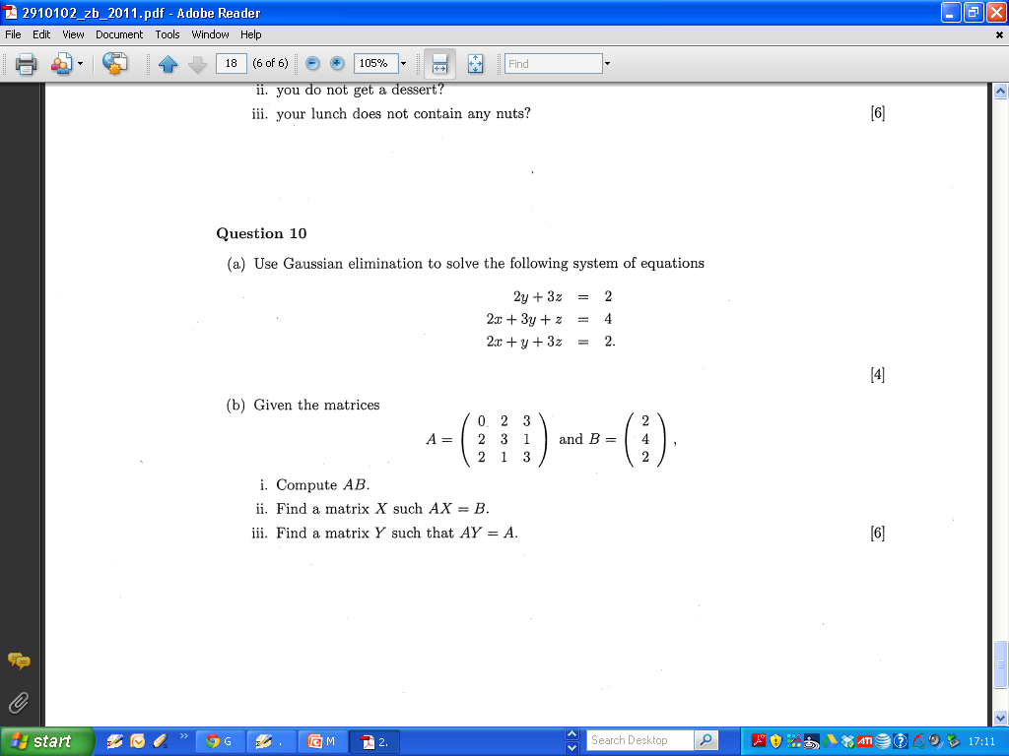
2011 Q 10 Zone B Part A

Slide 4
2011 Q 10 Zone B Part A

Slide 5
2011 Q 10 Zone B Part A

Slide 6
2011 Q 10 Zone B Part A

Slide 7
2011 Q 10 Zone B Part b

Slide 8
2011 Q 10 Zone B Part b

Slide 9
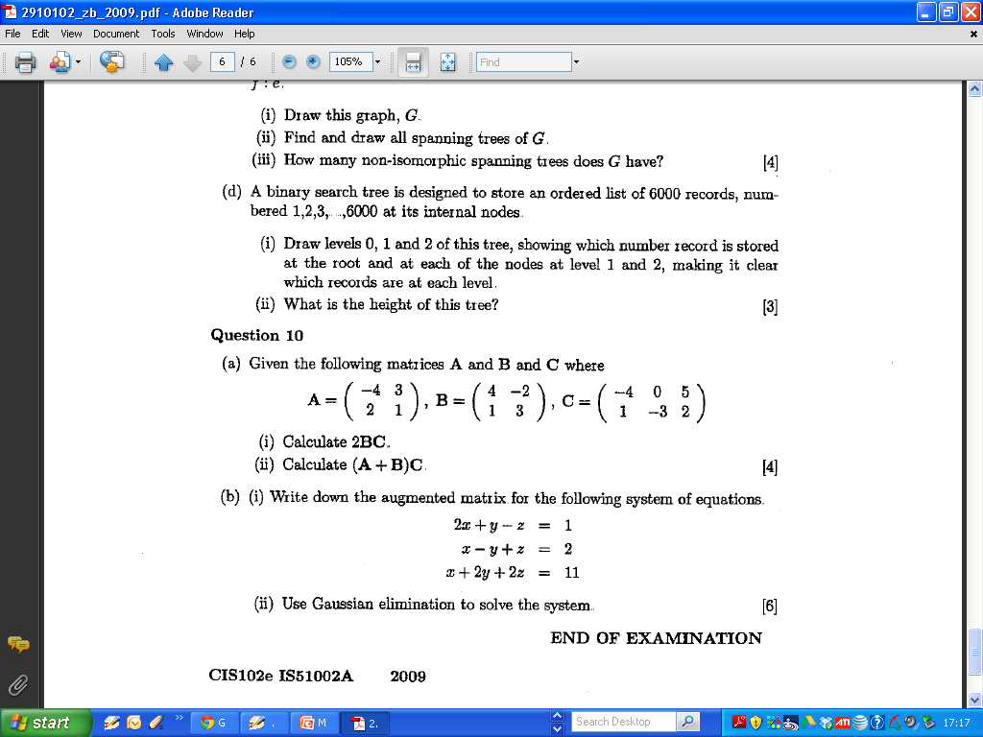
2009 Zone B Question 10 Part A

Slide 10
2011 Q 10 Zone B Part b

Slide 11
2011 Q 10 Zone B Part b

Slide 12
2009 Zone B Question 10 Part A

Slide 13
2009 Zone B Question 10 Part A

Slide 14
2009 Zone B Question 10 Part A

Slide 15
2009 Zone B Question 10 Part A

Slide 16
2009 Zone B Question 10 Part A

Slide 17
2009 Zone B Question 10 Part B

Slide 18
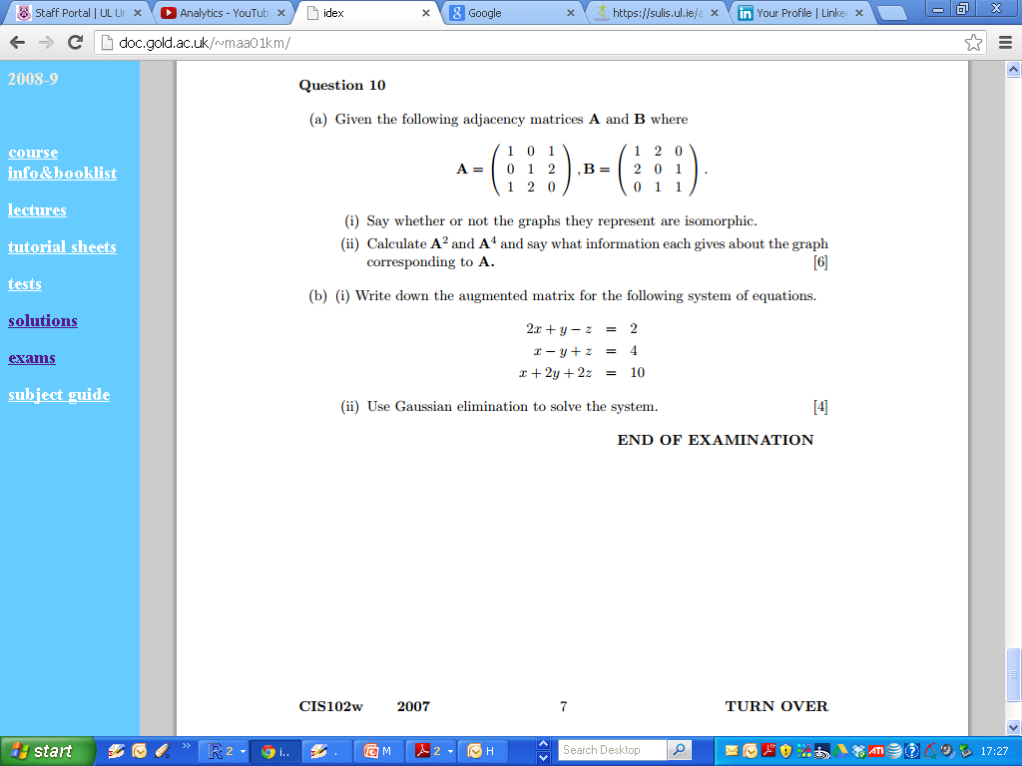
2007 Zone B Question 10 Part A

Slide 19
2007 Zone B Question 10 Part A

Slide 20
2007 Zone B Question 10 Part A

Slide 21
2007 Zone B Question 10 Part A

Slide 22
2007 Zone B Question 10 Part A

Slide 23
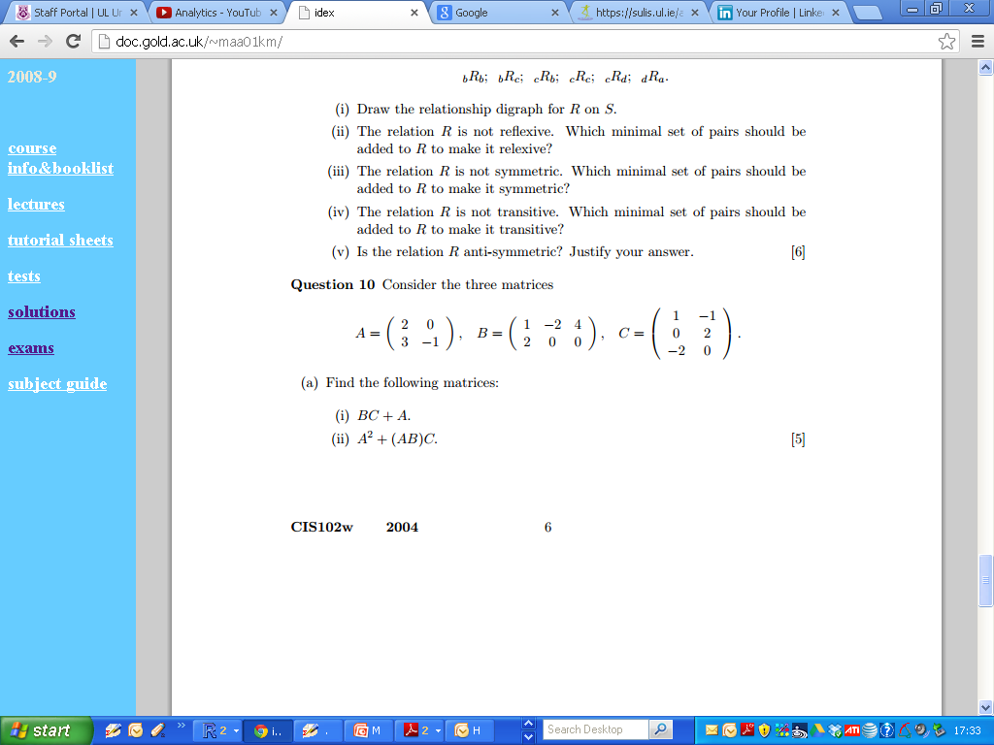
2004 Q 10 Zone B Part A

Slide 24
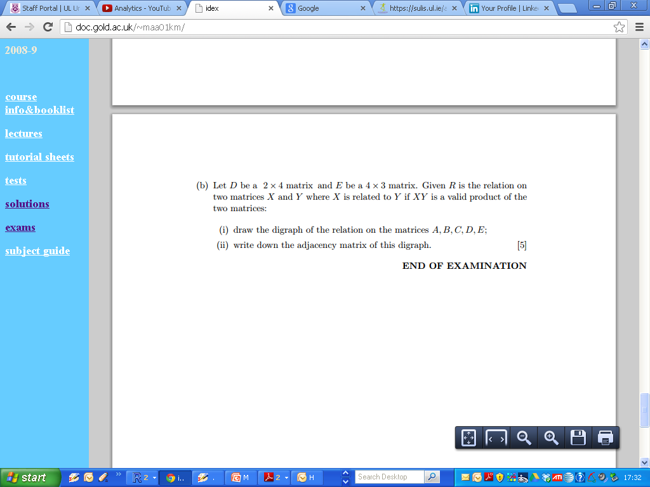
2004 Q 10 Zone B Part A

Slide 25
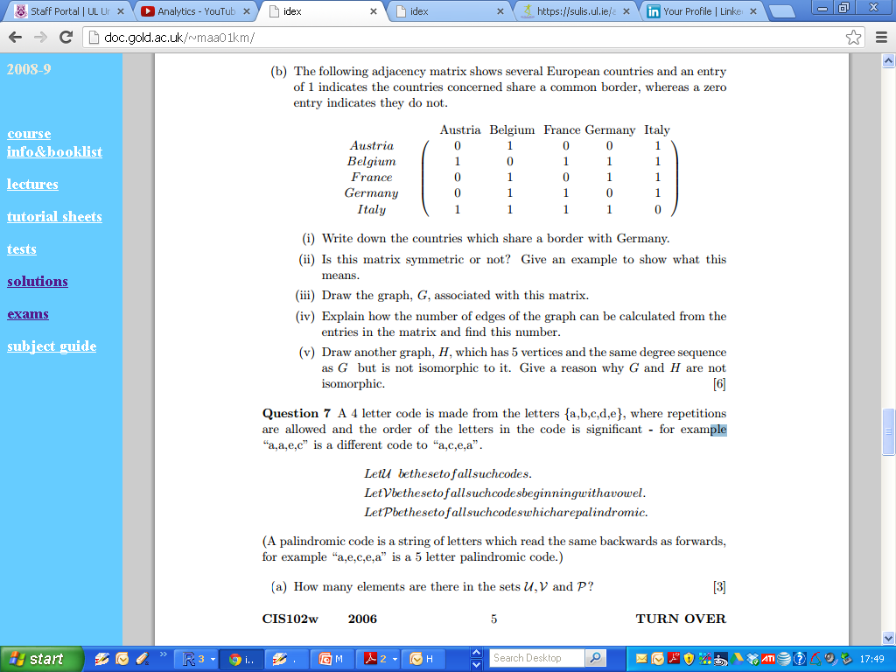
2006 Zone B Q7

Slide 26
2006 Zone B Q7

Slide 27
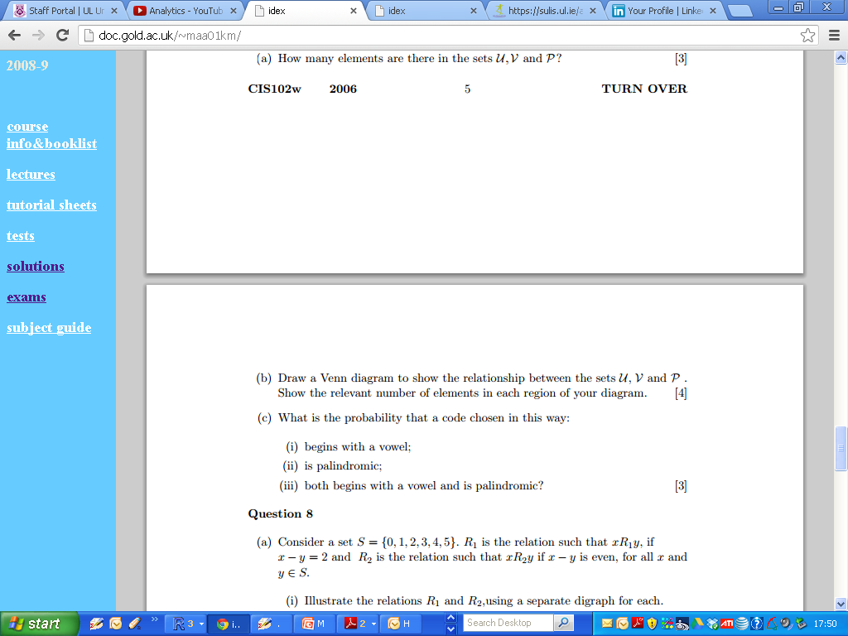
2006 Zone B Q7

Slide 28
2006 Zone B Q7

Slide 29
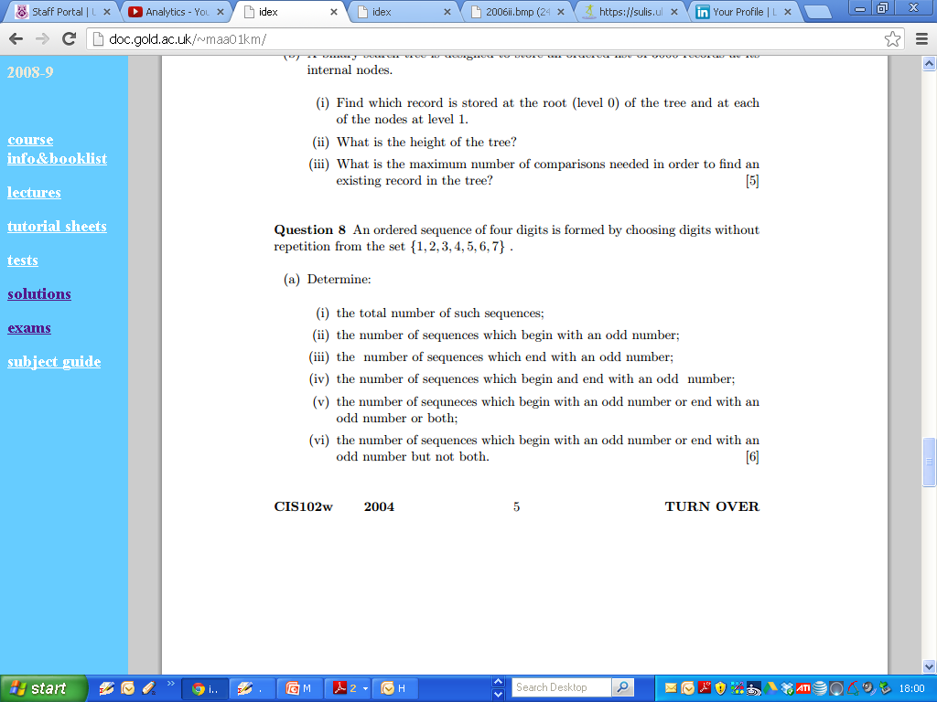
2004 Question 8

Slide 30
2004 Question 8

Slide 31
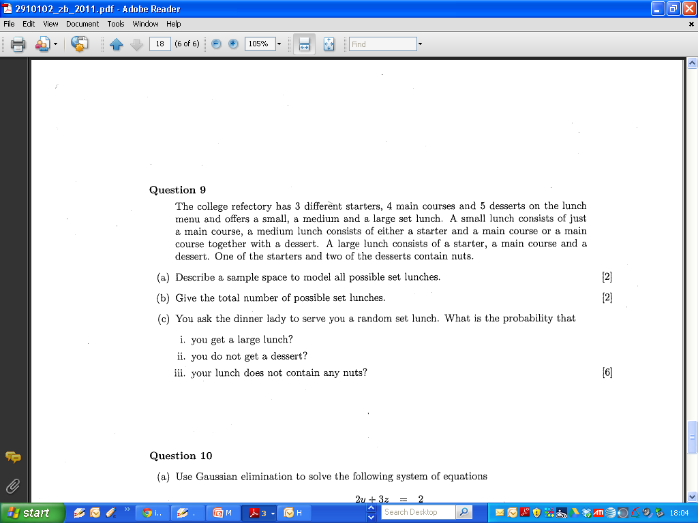
2011 Question 9

Slide 32
2011 Question 9

Slide 33
2011 Question 9

Slide 34
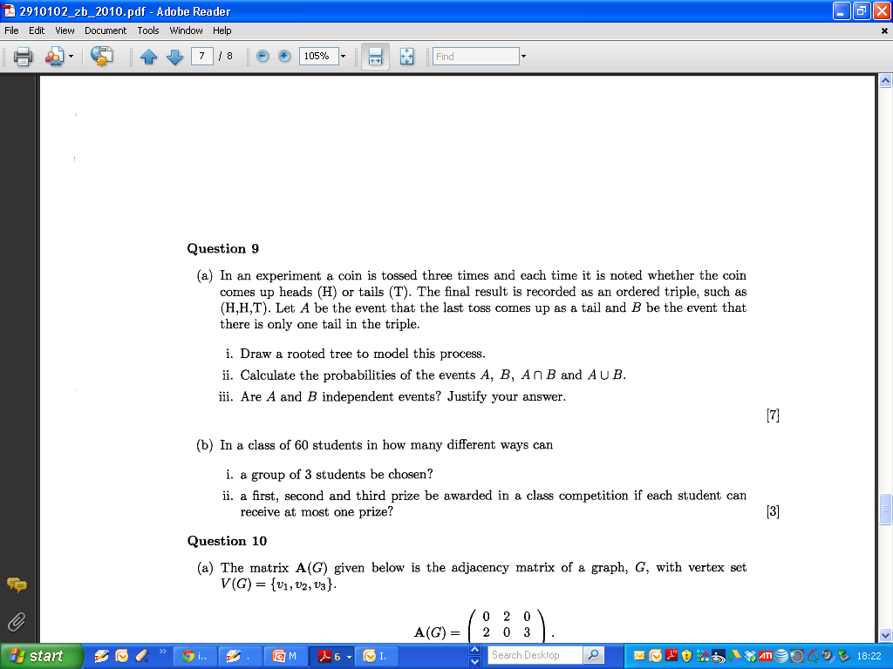
2010

Slide 35
2010 Zone B

Slide 36
2010 Zone B

Slide 37
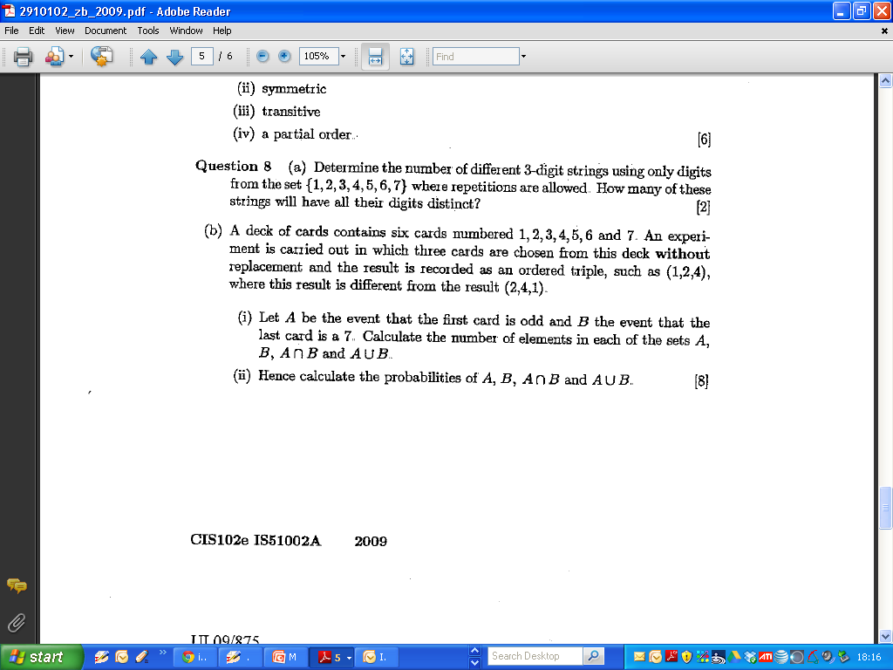
2009 Zone B

Slide 38
2009 Zone B

Slide 39
2009 Zone B

Slide 40
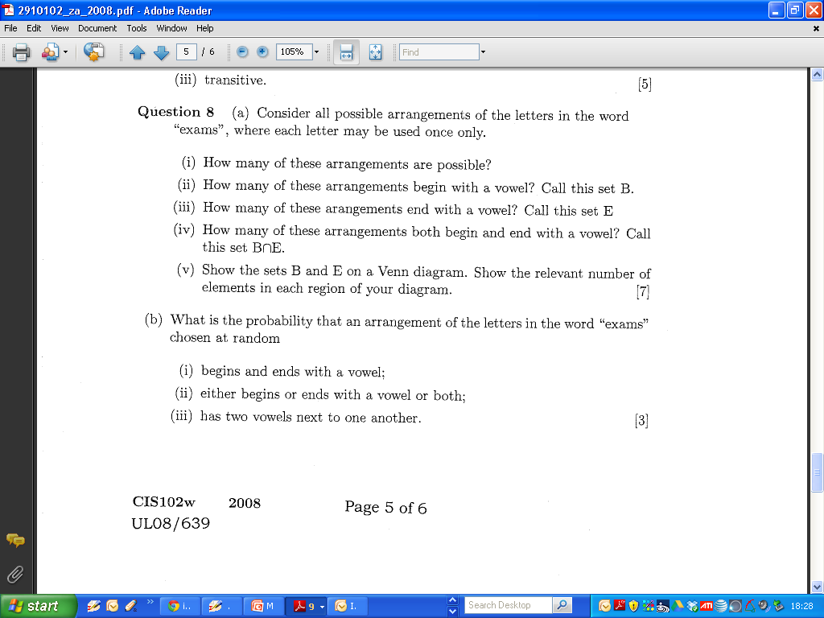
2008 Zone A

Slide 41
2008 Zone A

Slide 42
2008 Zone A

